Slide 1
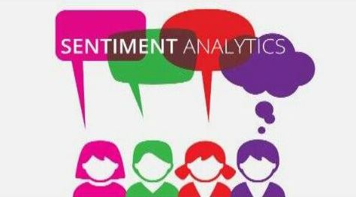
Sentimental Analysis

Slide 2
Introduction
• Popular microblogging site
• Short Text Messages of 140 characters
• 240+ million active users
• 500 million tweets are generated everyday
• Twitter audience varies from common man to celebrities
• Users often discuss current affairs and share personal views on various subjects
• Tweets are small in length and hence unambiguous

Slide 3
Index
Case-Study
Business Analysis
Political Leader
What is Sentiment Analysis?
Why Sentiment Analysis is important?
Problem Statement
Challenges
Approach
Result
Application
Conclusion

Slide 4
Case Study
Case study 1 : Business Analysis
Case study 2 : Political Leader

Slide 5
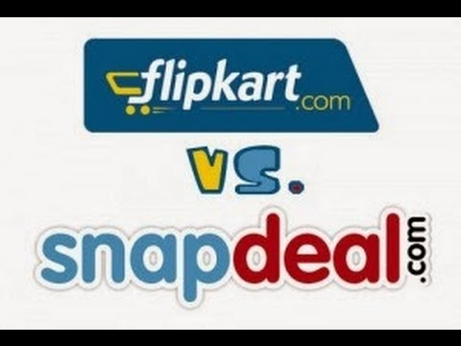
Case study on flipkart and snapdeal
With the big data growing bigger and bigger and social media disrupting every industry, monitoring data is one of the biggest challenges faced by the enterprises.
Using Social Media analytics tool, a sentiment analysis of Flipkart and Snapdeal on the occasion of ‘World Book Day’.

Slide 6
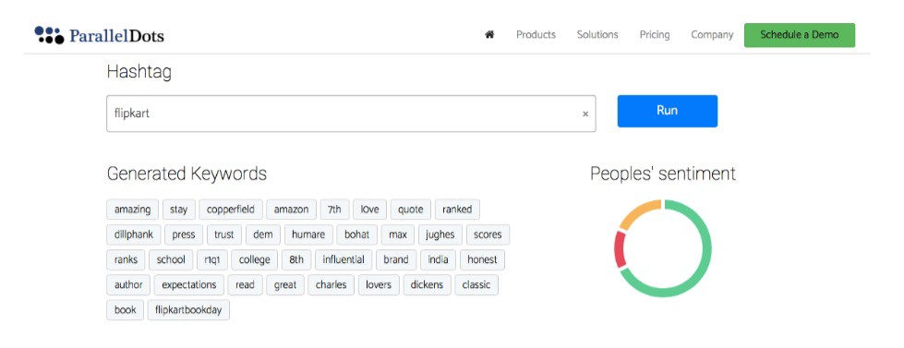
Flipkart
Summary of the Sentiment Analysis of Flipkart and Snapdeal on Twitter
While Flipkart is clearly being talked about on books with keywords such as ‘Dickens’, ‘Copperfield’, ‘college’, etc — these words are entirely missing from Snapdeal related keywords.

Slide 7
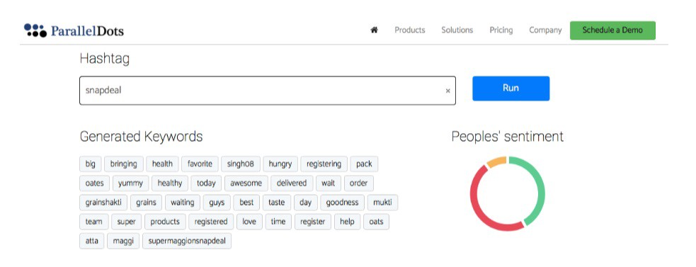
Snapdeal
Needless to say, people are talking positive things about Flipkart on world book day. On the other hand, Snapdeal is missing out on the opportunity presented by this occasion.
This also presents an incredible opportunity for Flipkart to run a solid marketing campaign around books ( space they and through which they kicked-off years back).

Slide 8
Case study on Narendra Modi
India the largest democracy has chosen a leader through the democratic process of elections.
Narendra Modi, (official prime ministerial candidate of BJP) has won with a spectacular victory and he will become the next prime minister of India after Dr. Manmohan Singh.by using the social media
As per a research conducted in meantime, it was predicted that Social Media can affect minimum 5% of total votes
Modi was leading in the election campaign since the beginning of it, in every kind of branding. Thus it leads to the huge setback to the congress party like never before.

Slide 9
The following are the some social media which used by the narendra modi:
Mission India 272+.com
It was the innovative decentralised electronic campaign introduced by the Narendra Modi in this election.
Blogging
Bolgging was the important medium throughout the campaign. Mr.Modi posted maximum updates containing information related development model of Gujrat, summary of his speeches, his projection about developing India etc.
Selfies
Mr. Modi clicked and posted selfies to attract the youth. Some small innovate ideas such as using hash tag #SelfieWithModi.
Appointment of Page Administrators
They have chosen Facebook because it is more popular than twitter in rural area of the country. They were imitating the national Modi campaign strategy on local level but with the same techniques.

Slide 10
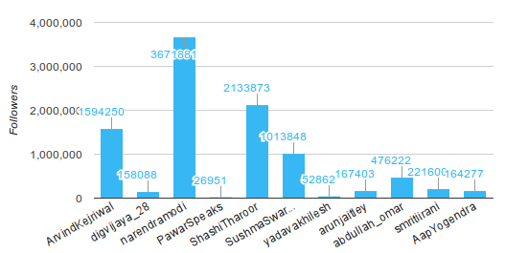
Twitter
Twitter is where Narendra Modi has generated the maximum buzz. Surrounded by more than 3.5 million followers, his voice gets amplified as most of his tweets get hundreds of retweets in no time!

Slide 11
What is sentiment analysis?
It is classification of the polarity of a given text in the document, sentence or phrase.
The goal is to determine whether the expressed opinion in the text is positive, negative or neutral.

Slide 12
Why Sentiment Analysis is important?
• Microblogging has become popular communication tool
• Opinion of the mass is important
• Political party may want to know whether people support their program or not.
• Before investing into a company, one can leverage the sentiment of the
people for the company to find out where it stands.
• A company might want find out the reviews of its products

Slide 13
Problem Statement
• Sentence Level Sentiment Analysis in Twitter:
Given a message, decide whether the message is of positive, negative, or neutral sentiment. For messages conveying both a positive and negative sentiment, whichever is the stronger sentiment should be chosen.

Slide 14
Challenges
• Tweets are highly unstructured and also non-grammatical
• Out of Vocabulary Words
• Lexical Variation
• Extensive usage of acronyms like asap, lol, afaik

Slide 15
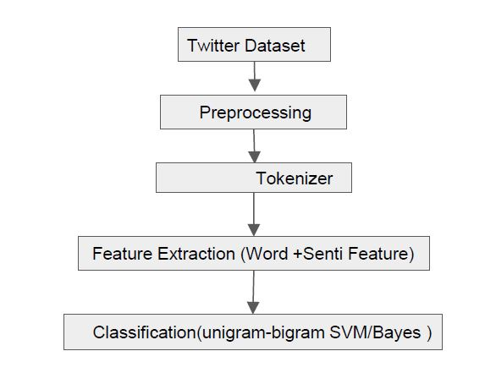
Approach

Slide 16
Results
Positive
Negative
Neutral

Slide 17
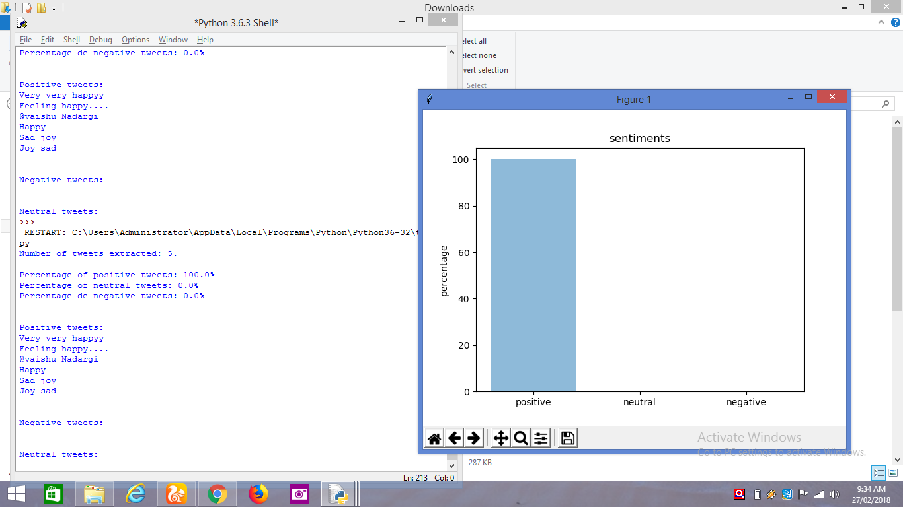
Positive

Slide 18
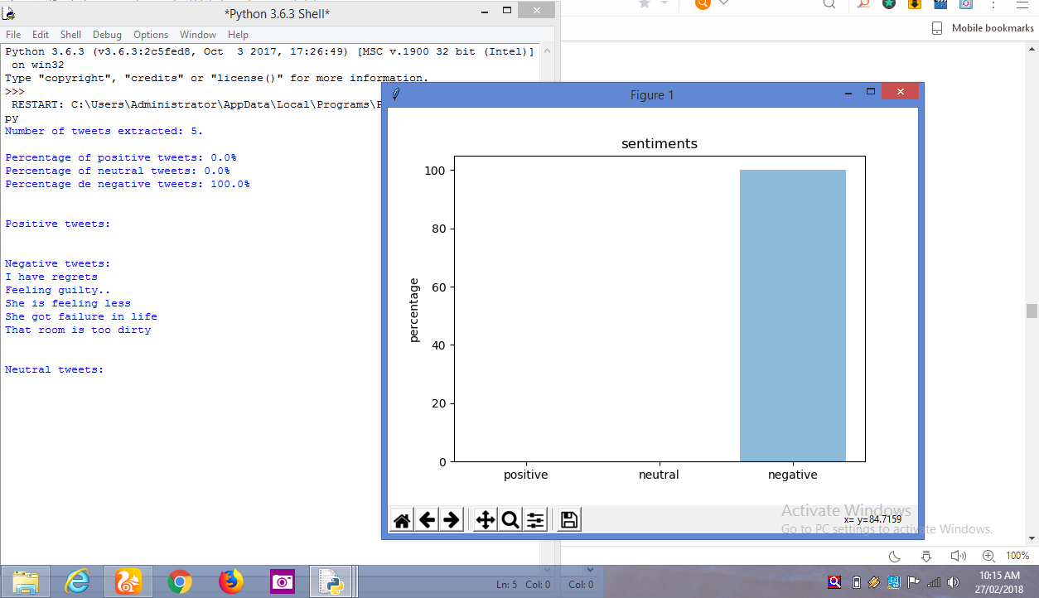
Negative

Slide 19
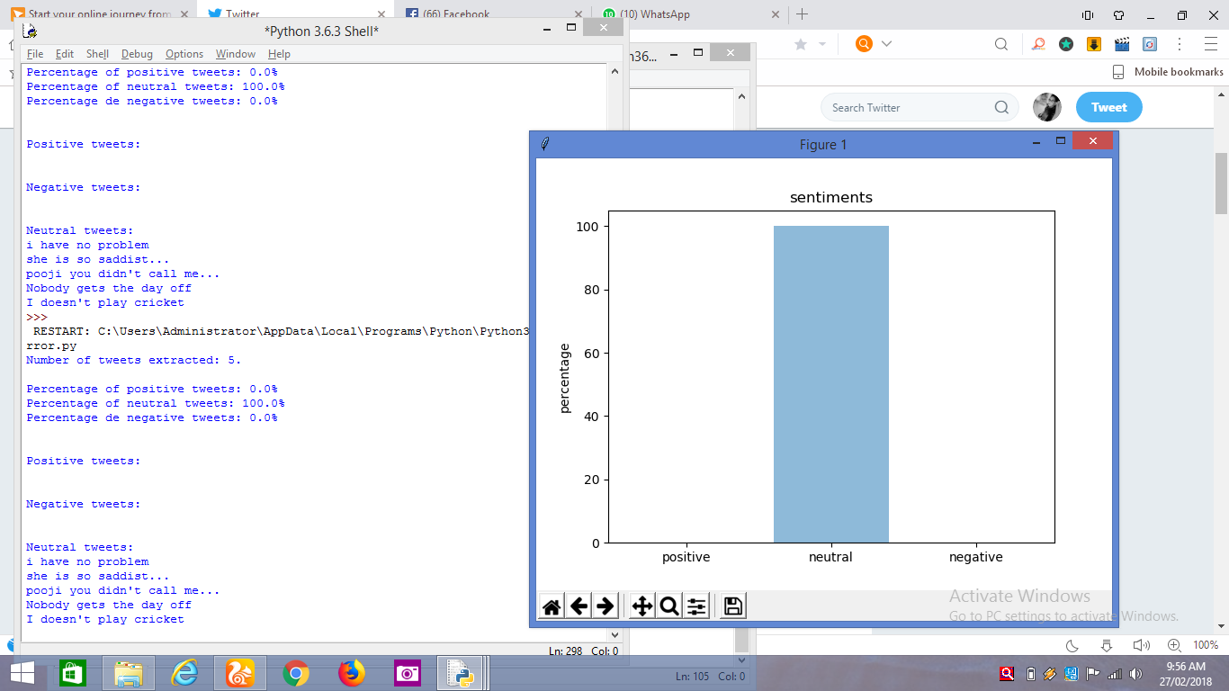
Neutral

Slide 20
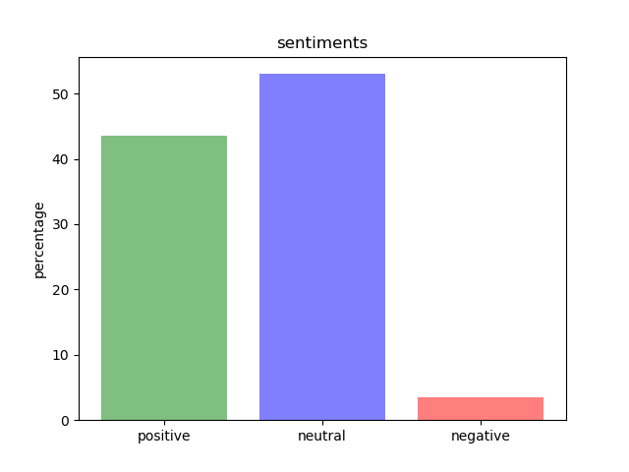
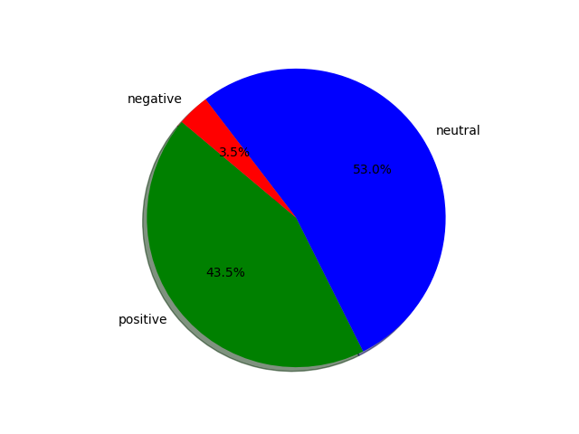
Narendra Modi

Slide 21
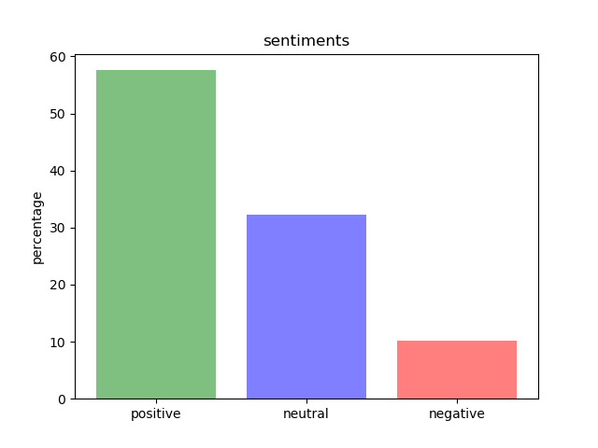
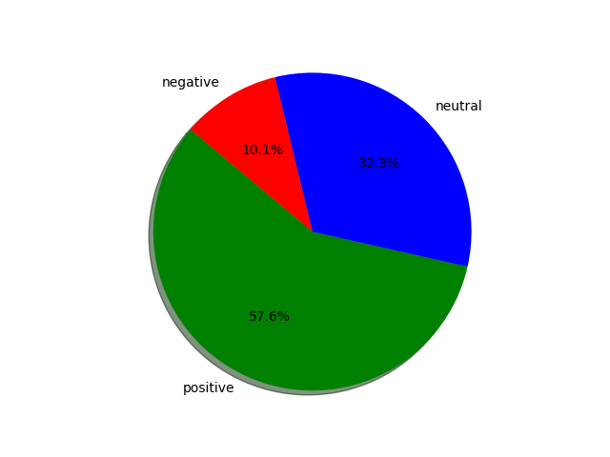
M.S.Dhoni

Slide 22
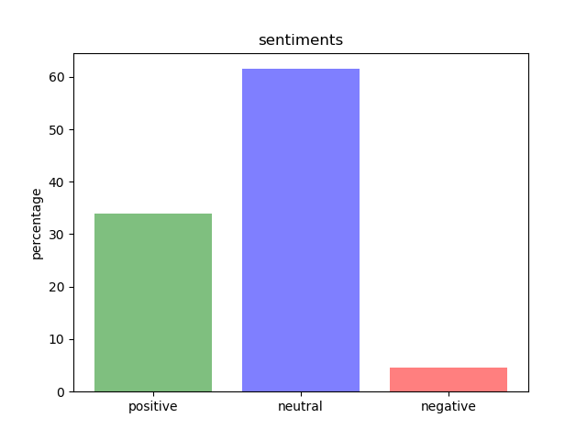
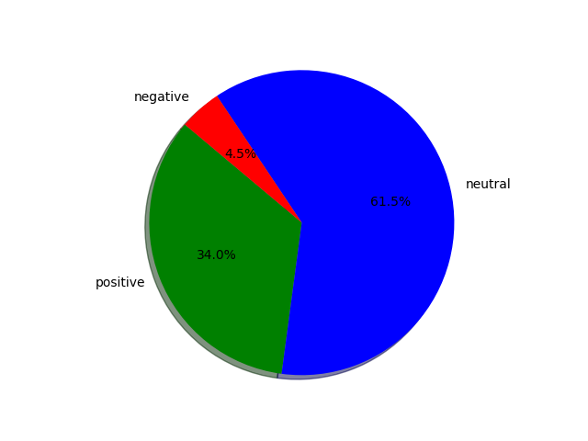
Salman Khan

Slide 23
Application
Knowing consumers attitude and trends
Knowing public opinions for political leaders
Movie review
Product review

Slide 24
Conclusion
We conclude that extracting features and POS tagging of tweets gives the best result using Navie Bayes classifier

